Slide 1

SPAM EMAIL DETECTION
FROM TEXT USING NLP
Department of Computer Science & Engineering
Submitted by
Submitted to
Taufiquzzaman Emon(1981)
Asma Binte Rashid(1982)
Faisal Ahmed
Assistant Professor,
Department of Computer Science and Engineering
Premier University, Chittagong.

Slide 2
Contents
Introduction
Related Work
Data Collection
Methodology
Results
Analysis
Discussion
Conclusion
References
Appendices

Slide 3
Introduction
Spam Emails Detection: Detecting and filtering out spam emails is a critical task for email providers and users alike, as it can help prevent fraud, malware infections, and phishing attacks Detect spam emails from a large dataset of labeled email messages, and the results are compared with those obtained using machine learning methods.
Prior work: To classify the email as either spam or not spam in various emails use a machine learning algorithm Naive Bayes.
Goal: The goal of this paper is to propose a novel approach for spam email detection that combines a rule-based method with machine learning.
Methodology: The methodology we used is Naive Bayes.

Slide 4
Related Work
Several approaches and algorithms have been proposed to address this issue, and various limitations and challenges have been identified in researched. In this section, we provide a comprehensive overview of the existing research related to spam email detection.
Mohamad and Selamat have proposed a spam email filtering system using two different features selection methods to classify the emails.
Machine learning algorithm based work for the classification of email data was presented by Harisinghaney et al.
Optimization based system is proposed by Al-Shboul et al. for the detection of spam mails.

Slide 5
Analysis:
The proposed approach for spam email detection, with machine learning, was evaluated on a large dataset of labeled email messages.
The results show that the proposed approach achieves higher accuracy and lower false positive rates than machine learning methods.
Collect data from kaggle.com
After collect data we pre-processed the text data.
We used Naive Bayes machine learning algorithms
Finally we evaluate our model by Naive Bayes Algorithm and see that the performance is 98%.
So, to increase accuracy in future we will used advanced algorithm like Random-forest, Bert, CNN, Artificial Neural Network classifier.

Slide 6
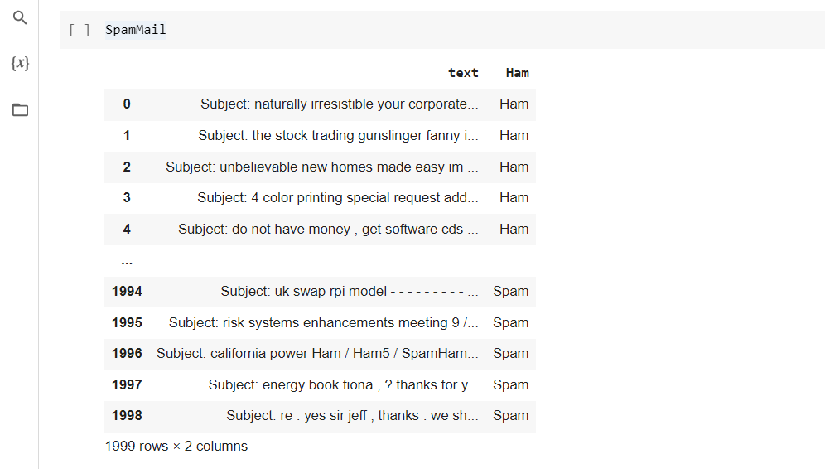
Data Collection

Slide 7
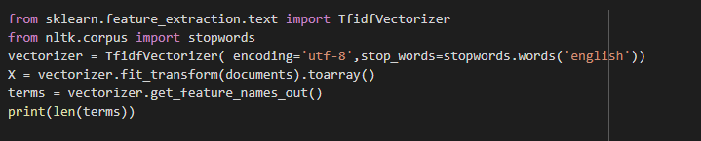

Methodology
Feature Extraction:To extract features from a document of words, we import –
from sklearn.feature_extraction.text import TfidfVectorizer

Slide 8


Model Building:
Creating Splitting and fitting the model : Import the KNN from the neighbours module of the sklearn library using-
from sklearn.neighbors import KNeighborsClassifier
Spilt the dataset.

Slide 9
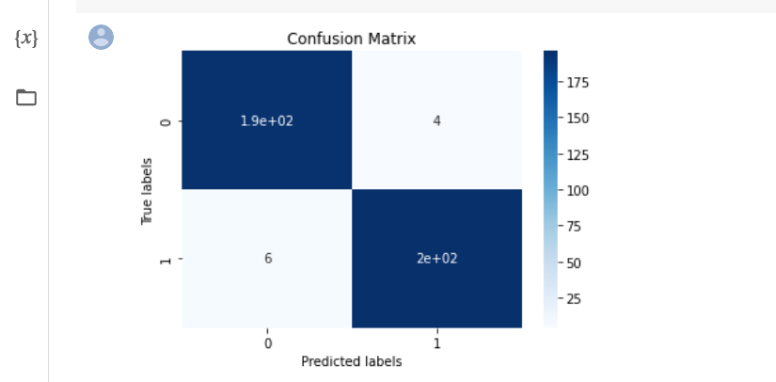
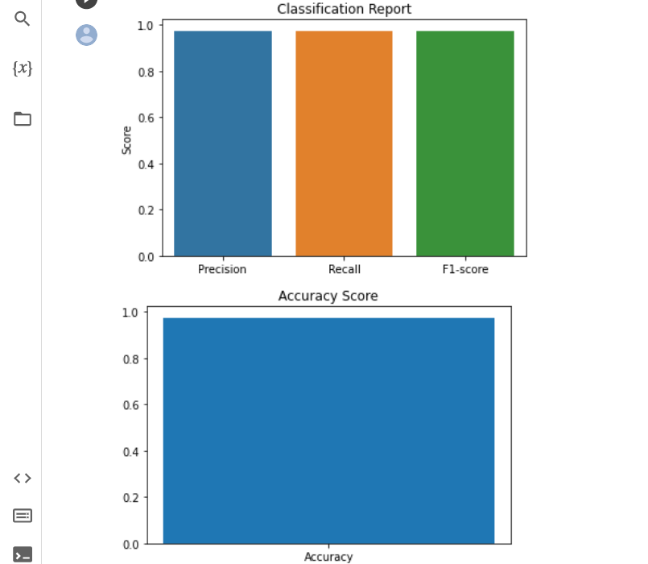
Model Evaluation:
Confusion Matrix:

Slide 10
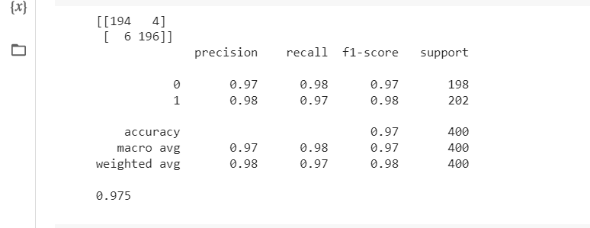
Result
Here, is the result of our confusion matrix,
Accuracy Score
Precision score
Recall Score
F1 Score

Slide 11
Discussion
The implication of this study is that it highlights the importance of using machine learning techniques for email security.
Traditional rule-based spam filters can be easily bypassed by spammers, whereas machine learning models can adapt and learn from new patterns and trends in spam emails.
One limitation is that the dataset used in the study was relatively small, and it may not represent the entire spectrum of spam emails.
Another challenge is that the proposed system may require periodic updates and retraining to maintain its accuracy

Slide 12
Conclusion:
In conclusion, this project aimed to develop a machine learning-based approach for detecting spam emails.
The project involved collecting and preprocessing email data, selecting and training machine learning models, and evaluating the performance of the models.
Overall, this project demonstrates the potential of machine learning for solving real-world problems and highlights the importance of data preprocessing in achieving accurate and reliable result.
The lack of standardized annotation processes for training data.
Future research in this field should focus on developing more robust and interpretable models.

Slide 13
References
1. Sahami, M., Dumais, S., Heckerman, D., & Horvitz, E. (1998). A Bayesian approach to filtering junk e-mail. In AAAI workshop on learning for text categorization.
2. Almeida, T. A., Gómez Hidalgo, J. M., & Yamakami, A. (2011). Contributions to the study of SMS spam filtering: New collection and results. Journal of Machine Learning Research, 12(7), 2699-2722.
3. Carreras, X., & Marquez, L. (2001). Boosting trees for anti-spam email filtering. In Proceedings of the conference on empirical methods in natural language processing (pp. 179-186).
4. Wu, S., & Li, Y. (2019). A deep learning approach for spam email detection. In 2019 10th International Conference on Information and Communication Systems (ICICS) (pp. 250-255). IEEE.
5. Cormack, G. V., & Lynam, T. R. (2014). Spam filtering: An empirical analysis. Foundations and Trends® in Information Retrieval, 8(4), 243-416.

Slide 14
Appendices
Finding Dataset
Data Description
Exploratory Data Analysis
Feature Selection
Additional Evaluation Metrics

